Slide 1


Revenue and Fleet Upgrade Analysis

Slide 2

Disclosure
This document contains LARIAT RENT-A-CAR confidential and proprietary information. The information disclosed within this document is intended for the sole purposes of providing information regarding your rental vehicle fleet, revenue/cost model, and anonymous client data and for analysis to improve revenue. Data for this analysis was provided by the LARIAT RENT-A-CAR and we are not responsible for any errors or omissions that may be caused from the data collection process.
Additionally, both parties agree not to use the information for any other purpose except as expressly provided herein. The parties also agree not to disclose, disseminate or otherwise make available this information to anyone, other than those employees who have a need to know in order to evaluate the information. All the information, statements and proposals in this document are correct and accurate to the best of our present knowledge but are not intended (and should not be taken) to be contractually binding unless and until they become the subject of separate, specific agreement between the parties.

Slide 3


Agenda
Business Objective
Review of the Business
Strategic Approach
Proposal
Estimated Impacts
Wrap up and questions

Slide 4
Objective
Provide analysis of how vehicles are performing to create a strategic vision to increase revenue.
Assist with decision making process when purchasing new vehicles for the fleet.
Notes:
Speak to why I was hired and what the means was to get to

Slide 5
Review of the Business
Notes:
Also discuss average rental rate as a KPI ($162.22/Day)

Slide 6
Strategic Approach
Strategy 1: Optimize the Fleet
Retire 2016 Model Year Vehicles.
Estimated $26M in sales for Vehicle Reinvestment.
Analyze the data to purchase the best performing 2018 Model Year Vehicles.
Focus on driving Revenue by increasing number of rentals.
Notes:
Analysis of this shows that volume alone does not drive revenue. Almost had 8x rentals but almost a 1M less net. Statista.com 36.8k new car 20.6K used car sale. Approx 55.% retain value.

Slide 7
Strategic Approach
Strategy 2: Develop Custom Model
(Lariat Score)
Create a formula that takes several KPI’s outputs a numerical value.
The value is weighted based on Unique Vehicles in the fleet.
Retire 2016 Vehicles.
Purchase best performing Lariat Score 2018 Vehicles
Lariat Score is calculated by:
(1-((Weighted Expenditures + Accidents)+(Weighted Rentals)+(Weighted Revenue)))
Notes:
Heavily weighted this towards Revenue and Cost from what we learned in strat 1.

Slide 8
Proposal
Retire and sell 1284 2016 Vehicles.
Estimated $26.4M in sales revenue.
Purchase 20 different vehicle models to replace the retired vehicles 1 for 1.
Estimated $47.2M in cost
These are the top performing vehicles based on Lariat Score
Increase the rental rate 10% to cover the cost of the new vehicles
This provides a diverse fleet of vehicles that will generate an estimated $10.6M more in net profit annually.
3 Year projections would $11M net profit.
Notes:
Net Profit = 10.6x3+26.4M-47.2M
Mention as of writing, vehicles keep value average of 55.5% or estimated 26M

Slide 9

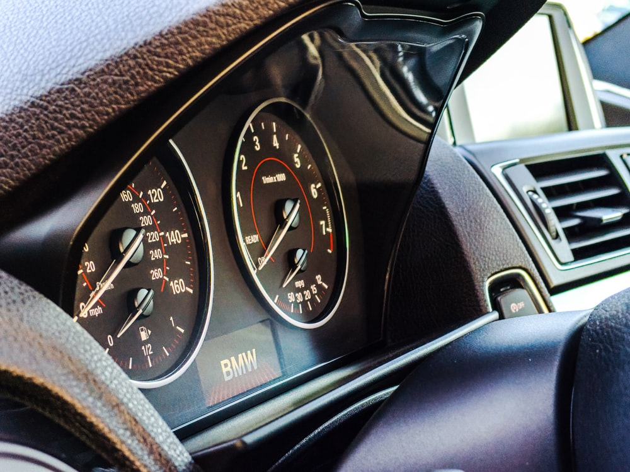
Proposal
Recommended Vehicles
Images courtesy Unsplash.com
Notes:
Net Profit = 10.6x3+26.4M-47.2M
Mention as of writing, vehicles keep value average of 55.5% or estimated 26M
Provides a little bit of everything, and Vehicles that perform well in Profit margin

Slide 10
Estimated Impacts
Notes:
Fleet simplicity without being bland
Potential for increased rental rate

Slide 11
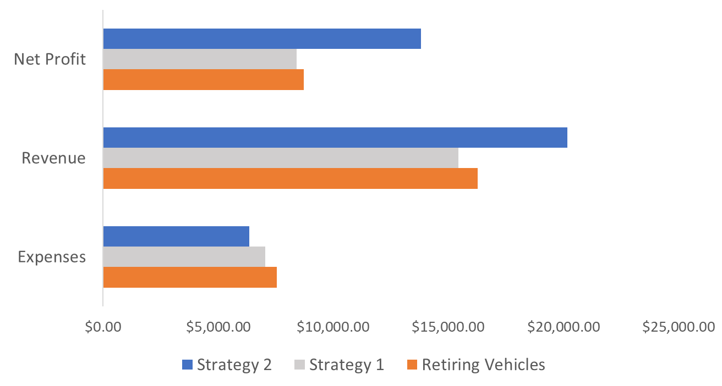
Estimated Impacts
Financial Performance Per Average Vehicle (in Dollars)
Notes:
Statista.com 36.8k new car 20.6K used car sale. Approx 55.% retain value.
Retired: 9.7M Cost
20.8M Rev
11.1M Net
53.6% Margin
31.9K Rentals
Strategy 1: 10.3M Cost
20.5M Rev
10.2M Net
49.8% Margin
248.8K Rentals almost 8x more
26.4M sales of 2016 Models
47.5M cost of new 2018 Models
Strategy 2: 7.9M Cost -1.8M
29.6M Rev +8.8M
21.7M Net +10.6M
73.4% Margin +20%
28.7K Rentals -3.2K

Slide 12
Questions?

